Slide 1
Understanding the Brain Drain Phenomenon in Iran
Sepehr Abbaspour, Yazdan Zandiye Vakili

Slide 2
Introduction
Topic Overview: Exploring the significant trend of migration and brain drain from Iran.
Key Focus: Understanding why skilled and educated Iranians migrate to countries like the USA, Canada, Germany, and the UK.
Reasons: Economic, political, and social factors driving this phenomenon.
Impact: Examining the implications on Iran's socio-economic development.
Presentation Goal: Provide a clear overview of the scale and impact of brain drain from Iran through data and diagrams.

Slide 3
Migration Stats & Ways
01
02
Numbers
Asylum
03
04
Educational
Research
Over 3.1M Iranian-borned have emigrated
(83% from 1979)
Since 1980, 1M Iranians applied for asylum.
(one third accepted)
About 700K have attended for foreign universities
Over 100K Iranian researchers are working with foreign institutions.

Slide 4
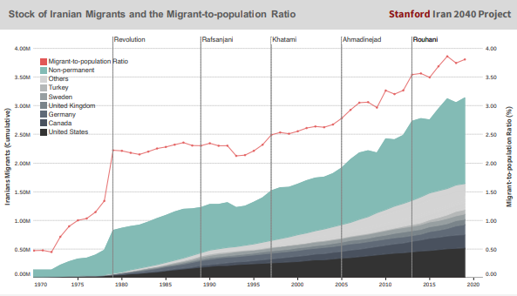
Target countries

Slide 5
Underlying Causes

Slide 6
01.
Quality of Education & Human capital Investment
How many years do you want to study ???

Slide 7
Improved education in Iran since the mid-1980s.
More focus and investment on each child's education.
Higher levels of learning among Iranian youth.
Better education encourages studying and working abroad.

Slide 8
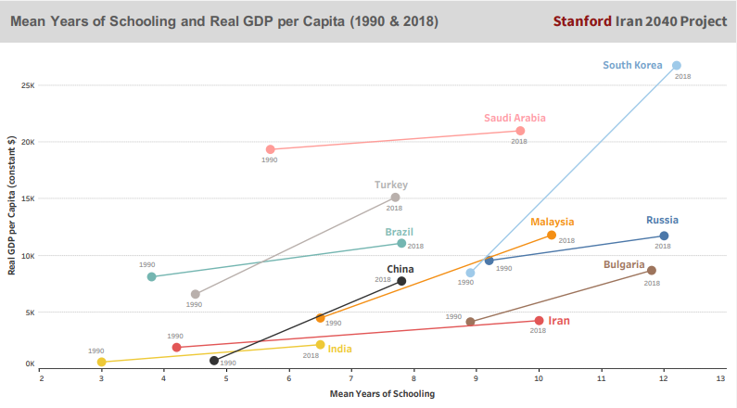
Longer Years of Education

Slide 9
02.
Economic Factors & Per Capita Income Trends
How much do you spend for you education ???

Slide 10
Economic conditions influence migration choices.
Iran's income per person:
  Sharp increase in the 1970s (oil windfalls).
  Decline in the 1980s.
  Slow recovery until mid-2000s.
  Stagnation since then.
Poor economic outlook and stagnant living standards drive migration.
Highly educated seek opportunities abroad due to these conditions.

Slide 11
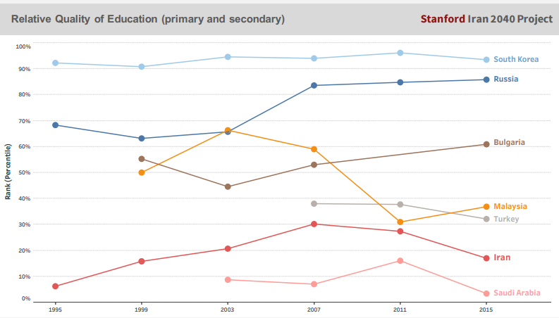
Quality of Education

Slide 12
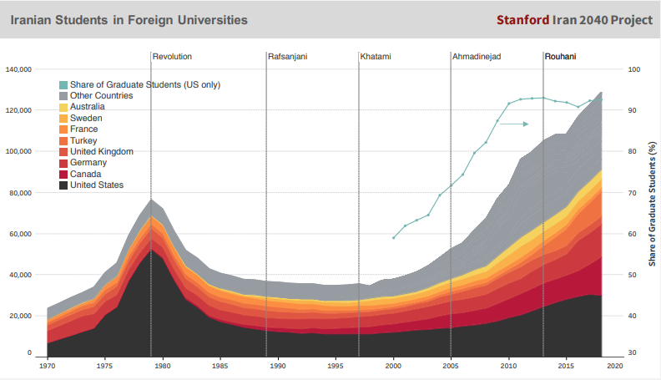
Students Destinations

Slide 13
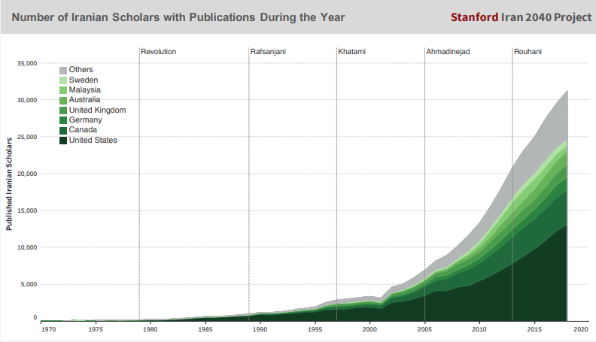
Scholars Destinations

Slide 14
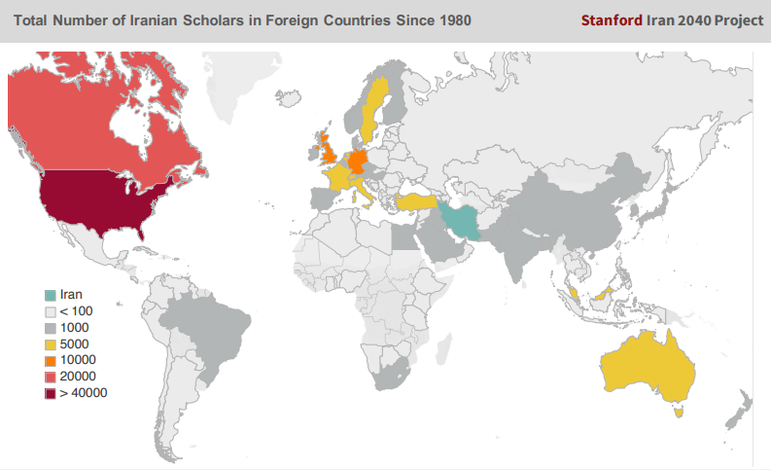
Scholars Destinations

Slide 15
03.
Political & Social Repression
Do you agree with the policies in Iran ???

Slide 16
Social and political repression, human rights violations are major migration motivators.
Issues include:
  Lack of democratic institutions, such as free and multiparty elections.
  Crackdowns on civil society.
  Mandatory hijab enforcement.
  Pressure on religious minorities.
  Strict control over relationships and personal freedoms.
  Homophobia.
These factors contribute to Iranians seeking more liberal and democratic societies abroad.

Slide 17
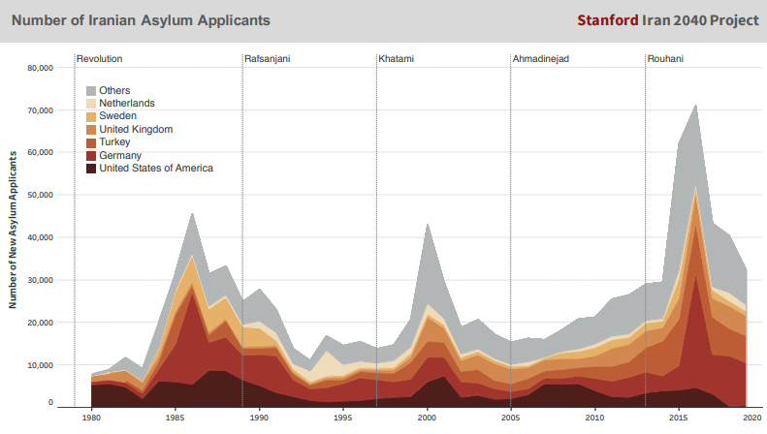
Asylum Applications

Slide 18
04.
Environmental issues
How is the weather today ???

Slide 19
Environmental issues influence migration decisions.
Key concerns:
  Extreme air pollution in cities.
  Water scarcity.
Current impact:
  Internal displacement within Iran.
Future potential:
  Could lead to international migration of environmental refugees if conditions worsen.

Slide 20
Drivers of Migration
Predisposing
Proximate
Precipitating
Mediating
Evolve over a very long term
Evolve over long term
Events
Catalysts

Slide 21
Predisposing Drivers
Lower income per person compared to advanced economies.
Social and political repression, human rights violations, and religious persecution.
Lower quality of education compared to developed countries.
Increase in labor mobility, urbanization, individualism, and secularism.

Slide 22
Proximate Drivers
Economic stagnation, chronic unemployment, and a bleak economic outlook.
Decay of government institutions, state rule of law, and accountability.
Loss of social capital, prevalence of corruption and crime.
Environmental challenges, especially air pollution in large cities.

Slide 23
Precipitating Drivers
Iran-Iraq war (1980–1988).
Academic cleansing program during the cultural revolution (1980–1983)​
Government crackdown on dissent in protest on 1999, 2009, 2017, 2018, 2019
Very high inflation shocks
State’s poor responses to natural disasters
Major Economic Sanctions imposed in 2012 and 2018

Slide 24
Mediating Drivers
Increase in internet penetration
Increase in number of friends and family abroad

Slide 25
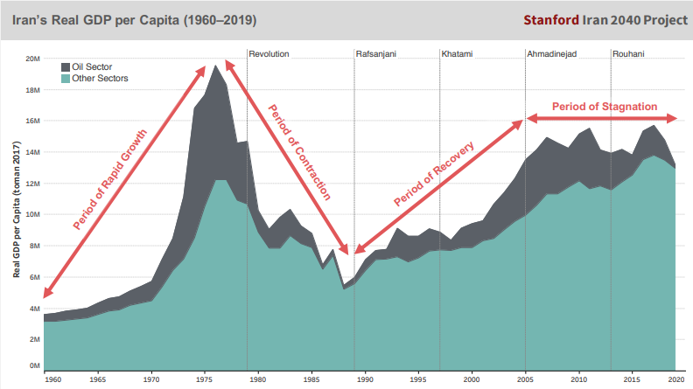
Iran’s Real GDP per Capita

Slide 26
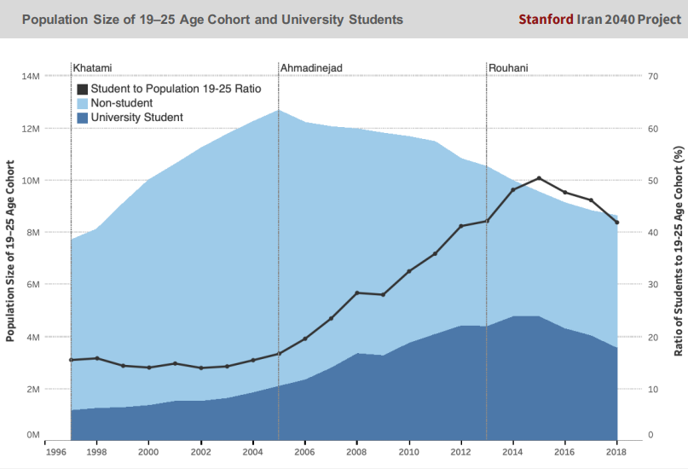
Students Population

Slide 27
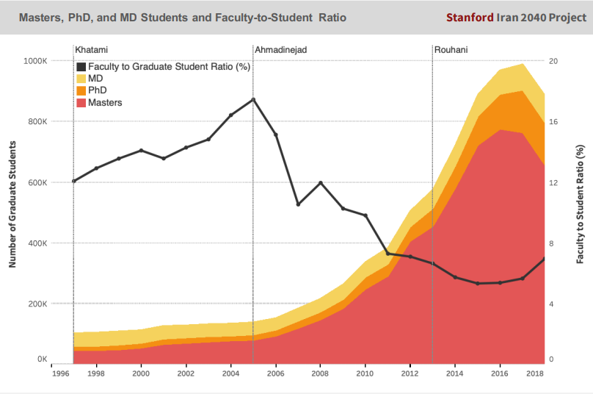
Graduate Students Population

Slide 28
John. F. Kennedy
Do not ask what your country can do for you, ask what you can do for your country.

